Slide 1
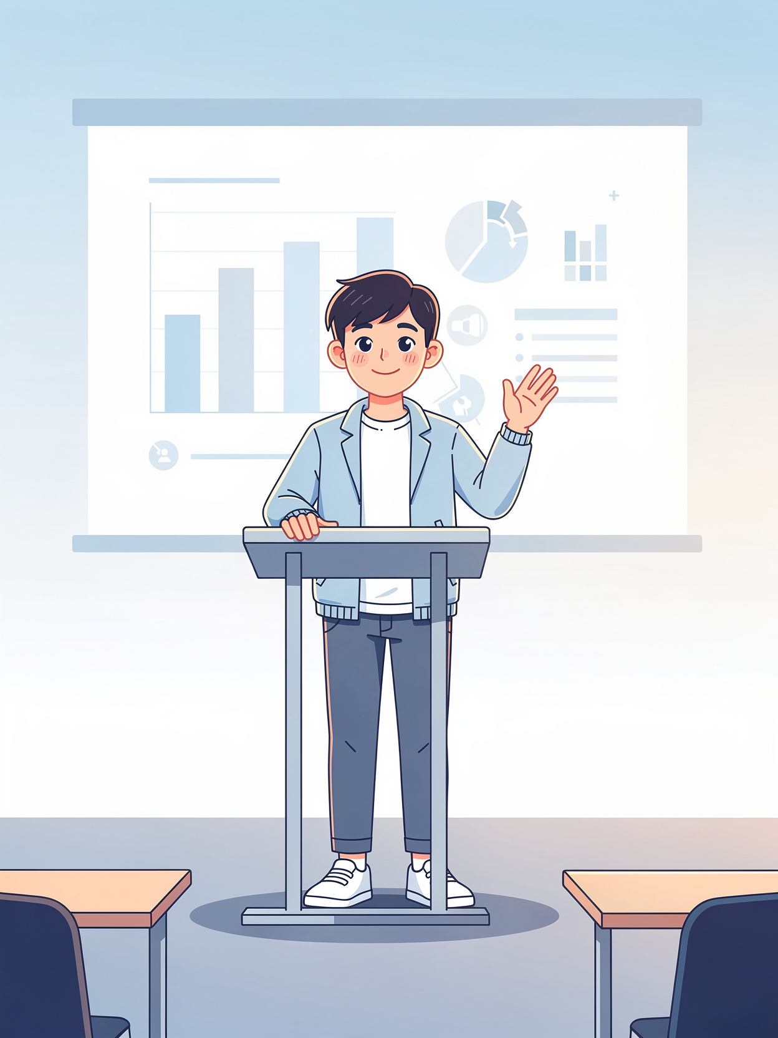
Session 25: Deliver & Reflect

Slide 2
Objectives
By the end of this Session, you will have accomplished 5 things:
01
02
03
DELIVERED
DEFENDED
RECEIVED
Your full presentation - all 9 slides
Your investigation under reviewer-style questions
Mentor feedback on your work and your 25-session growth
04
05
REFLECTED
MAPPED
On what changed in you across 25 sessions
Specific next steps for what comes after this program

Slide 3
How This Session Flows
Welcome + final prep
Your presentation + Q&A
Feedback on work + growth
Reflection conversation
Pathway mapping + close

Slide 4
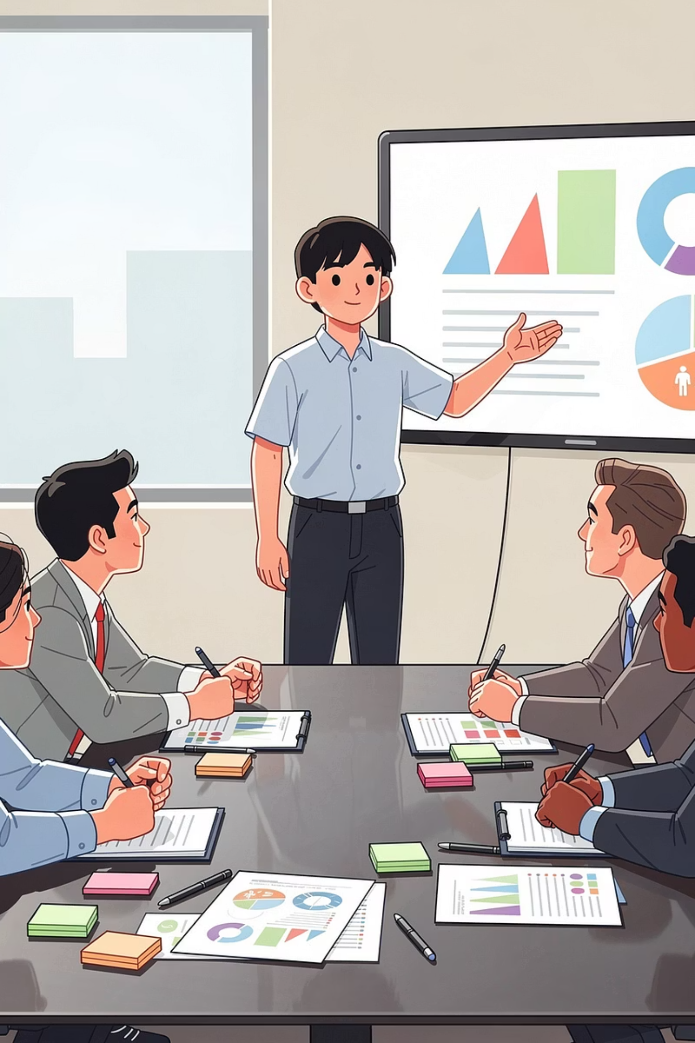
Your Presentation 🎤
You'll present your investigation now, using the Gamma slides you built and practiced.

Slide 5


Your Reflection
Before & After
Biggest Surprise
Turning Point
Proudest Moment
Do-Over
Meaning
There's no right answer to any of them. The goal is to articulate, in your own words, what changed in you.

Slide 6




What This Capstone Was Designed to Do
Frame a Research Question
Find Credible Sources
Investigate with Depth
Communicate Findings

Slide 7
What's Different About You Now
Use AI for REAL Work
Detect Hallucinations
Spot Bias & Safety Issues
Investigate Seriously
Write to a Research Structure
Present Under Pressure

Slide 8
How Your View of AI Evolved 🧭
Where You STARTED
Where You're ENDING
You came in with whatever you thought AI was:
A more accurate picture:
Maybe a magic tool
Maybe a threat
Maybe something in between
A useful tool that can also be WRONG, BIASED, and UNSAFE
Technology that needs HUMAN OVERSIGHT
A field changing FAST
A domain being shaped by WHO BUILDS it and HOW

Slide 9
The Research Framework Is YOURS Now
You investigated ONE domain. Now you know how to investigate ANY domain.
The 4-stage framework you used works for anything you want - AI in finance, climate solutions, mental health, local policy - ANYTHING.
🔍 DISCOVER
📚 RESEARCH
🛠️ ANALYZE
🎤 DELIVER

Slide 10
Your Prompt Library 📚
📋 A Real Collection
🎯 Why It Works
Your tested prompts for ChatGPT, Gemini, NotebookLM, image gen, voice gen, and more
The prompts are specific to use cases YOU encountered. They work because YOU tested them.
🚀 How to Use It Forever
When you investigate new topics
When you write school papers
When you experiment with new AI tools
When you teach friends or family

Slide 11
Sharing Your Work - Real Publication 📰
Your paper has a structure used in real research. Several journals accept submissions from STUDENT researchers.
The International Journal of Engineering and Science
International Journal of Research in Engineering, Science and Management
American International Journal of Social Science
theijes.com
aijsh.com
ijresm.com
National Association for Interdisciplinary Research
RSIS International
International Journal of Novel Trends in Research
rsisinternational.org
nairjc.com
ijntr.org

Slide 12
Your Achievements - Look Back
Learned how AI actually works
Trained your own AI models in Teachable Machine
Used different AI tools
Built a real working app in Lovable
Investigated bias, hallucinations, deepfakes
Wrote and defended a research paper

Slide 13
The Six Big Ideas You Now Hold 🧠
AI Isn't Really Thinking
Data Is Everything
AI Is Bounded
Confidence ≠ Accuracy
AI Is Designed
AI Has Parts

Slide 14


Final Mini Activity - Your One Sentence Promise
"After this course, I will ___________________________."
Examples to spark your thinking:
"...keep asking how the apps I use actually work."
"...double-check important facts AI tells me."
"...use AI to help me learn - not to skip learning."
"...stay curious about how things work."

Slide 15

Stay curious.
Stay honest.
Keep building.
The capstone ends. What you do next doesn't have to.

